Slide 1
NODE.JS
(The Backend Of MERN Stack)
Lecture 24

Slide 2
Today’s Agenda
What Is MySQL?
MySQL SetUp
Logging In
Concept Of Database & Tables
Creating Database
Data Types
Creating Tables
Inserting And Viewing Records

Slide 3
What is MySQL?
MySQL is an immensely popular Relational Database Management System (RDBMS) - and has for a long time been favorite of back-end engineers working with Java or PHP.
With the advent of JavaScript for the back-end, via Node.js , now MySQL is also commonly used as the database for projects and applications built with Node.

Slide 4
Mysql setup
Before starting with Node-MySQL connectivity we have to confirm that MySQL Community Server and client packages are installed and working properly in our system.
To install MySQL please follow the steps mentioned in the installation guide.

Slide 5
Using mysql
In MySQL we need to go through following steps to create a table and insert records in it:
Login to root user using MySQL Command Line Client by entering the password we setup during the installation.
Create a database using create database command.
Activate the database using use database command.
Create the table using create table command.
Finally insert records into the table using insert into command.

Slide 6
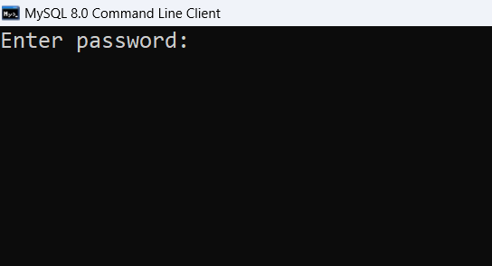
Logging in
Launch the MySQL Command Line Client and it will prompt us to type in the password:

Slide 7
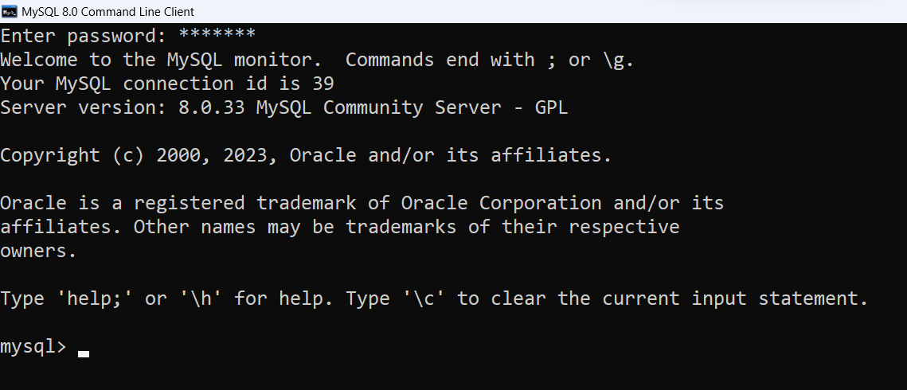
Logging in
Type the password and press ENTER.

Slide 8
Database & tables
A database is an organized collection of data, typically stored in a computer in table forms.
We can consider a database to be like a folder where we'll store all our tables and under our tables, we'll have our rows and columns.

Slide 9
Database & tables

Slide 10
Database & tables

Slide 11
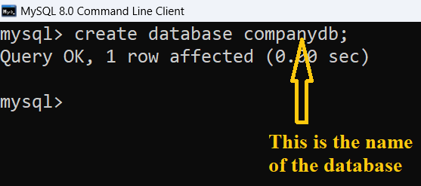
Creating a database
In MySQL to create a database we use the command create database<database_name> as shown below:

Slide 12
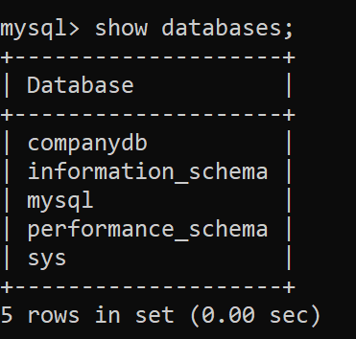
verifying database existence
In MySQL to check whether a database is present or not we can use the show databases command as shown below:

Slide 13
selecting a database
MySQL Server can contain multiple databases and can serve multiple clients simultaneously.
So, when a client connects to or opens a MySQL command prompt, he has to select a database to run the SQL queries or operations.

Slide 14

selecting a database
To select/activate a database we need to use the command use database<database_name> as shown below:

Slide 15
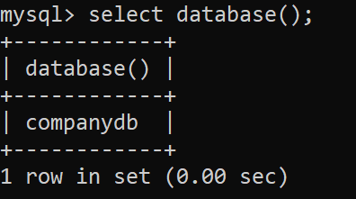
Verifying selected database
To verify which database is currently selected for operations we need to use the following command select database( ) as shown below:

Slide 16
Mysql data types
There many different data types supported by MySQL and they are grouped into five main categories:
Numeric data types
Date and time data types
String data types
Spatial data types
JSON data types

Slide 17
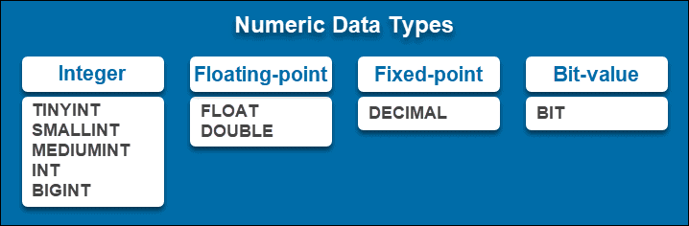
Numeric data types

Slide 18
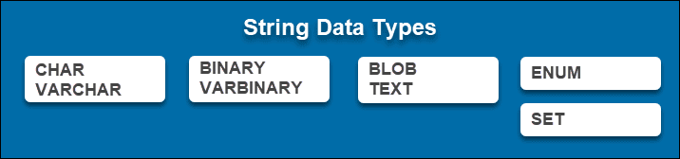
string data types

Slide 19

date/time data types

Slide 20
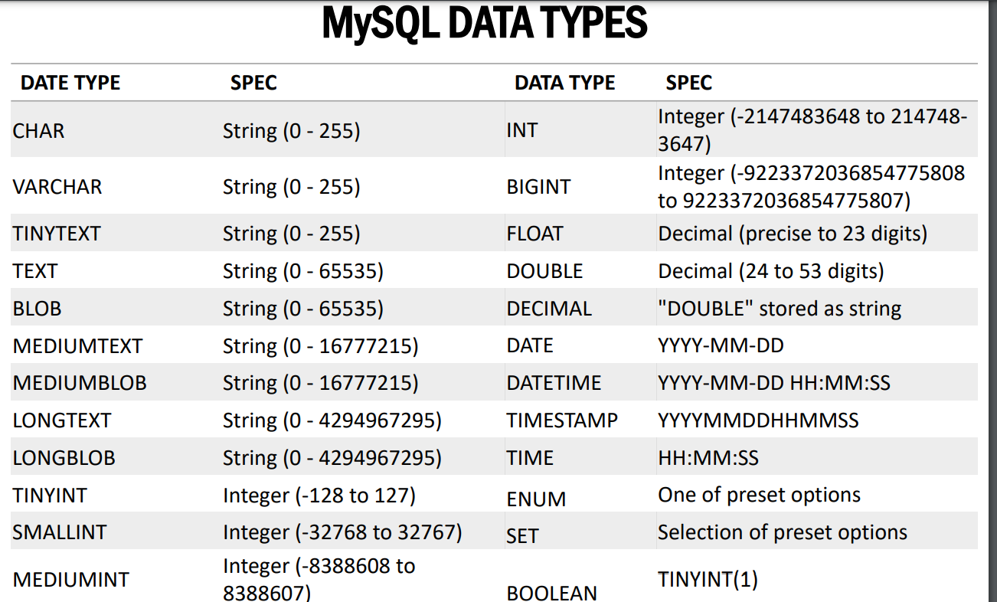
Data types in detail

Slide 21
Creating a table
In MySQL to create a table we use the command create table <table_name> as shown below:

Slide 22
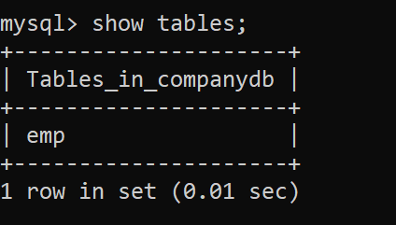
listing all tables
In MySQL to list all the available tables inside a database we can use the show tables command as shown below:

Slide 23
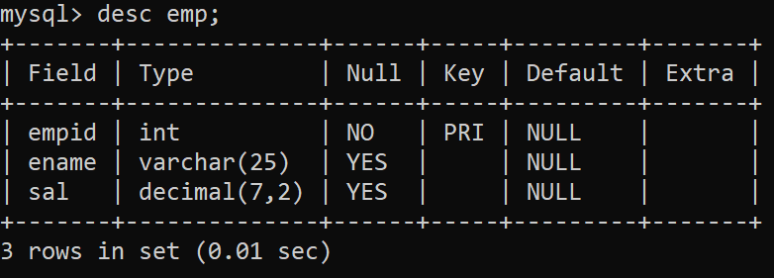
Viewing structure of a table
In MySQL to view a table’s structure we use the command desc <table_name> as shown below:

Slide 24
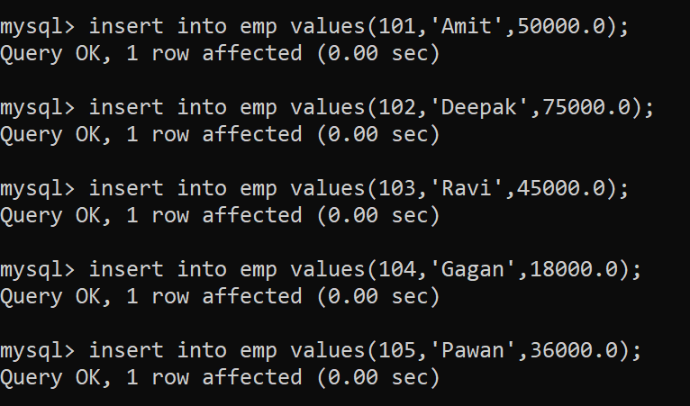
Inserting records in a table
In MySQL to insert records in a table we use the command insert into as shown below:

Slide 25
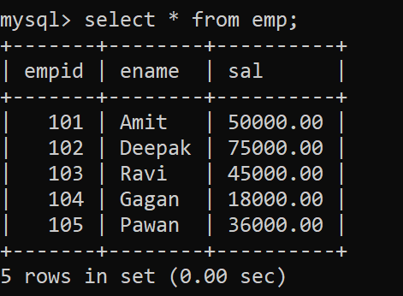
viewing records
In MySQL to view records we use the command select as shown below:

